Slide 1
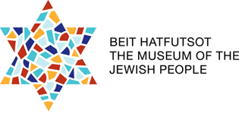
International Programs You Are Part of the Story

Slide 2
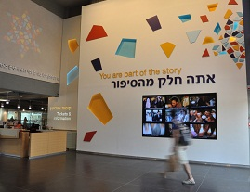

Slide 3
Peoplehood: Converting Structures into Assets
Jewish creation and creativity
The world of Jewish values
Jewish practices and spirituality
Historical memory
Hebrew and Jewish languages
Israel as a multidimensional concept (Eretz, moledet, medinah)

Slide 4
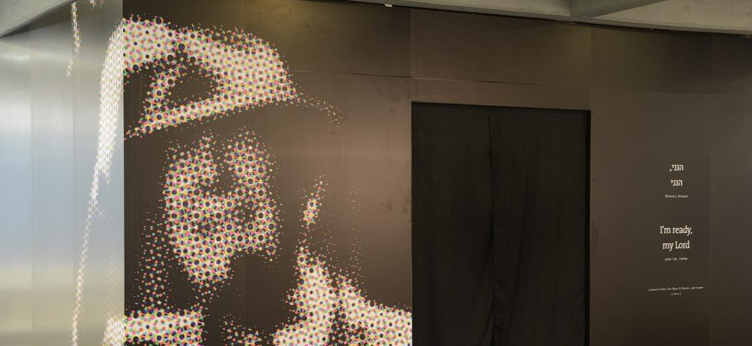
Hinneni: I’m ready, my Lord

Slide 5
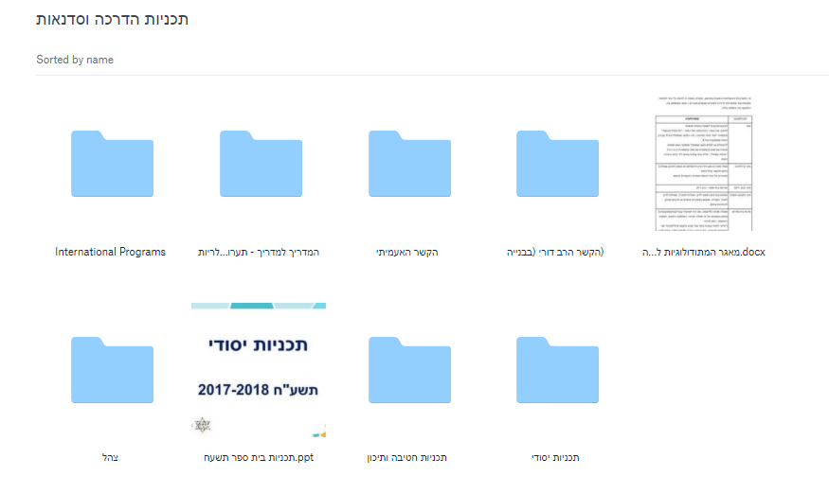
Dropbox Materials
International Programs

Slide 8
International Programs
Who is our audience?
Jewish visitors arriving in an organized group, seeking BH content.
Youth groups, synagogue missions, partnerships, families, student groups -- Taglit, Masa, gap year programs, etc.
Vision:
Every hadracha is a program. The tour is not your basic "museum docent tour" its an engaging educational experience – for all ages.
That's how we market, and that's how we view everyone here – museum educators, giving a meaningful and inspiring experience. We bringing the discussion into the gallery.
4 International Programs
Program: Gallery Tour or Gallery tour + workshop
Every tour has a different theme and emphasis, but the galleries might be the same. Magic as guide – we use the same galleries, and each time have the ability to give emphasis to different themes.

Slide 9
Inspire Your Story
Tour (time frame: 1.5-2 hours)
Includes 3-4 Galleries: Synagogue Gallery / Dylan / Operation Moses / CHIM / Jewish Lens / Jewish Humor / Glimpse into Heroes
+ Summary (15 minutes)
Methods
Use smartphone: Choose a display that _____ (reflects connection to the Jewish People? something that inspires me? reminds me of my own family?)
Share experiences and memories: have participants share and highlight similarities and differences
“World map”: Where are you from? Parents? Grandparents?
Museum Midrash in Chim / The Jewish Lens
Optional Workshop (Up to 1 hour)
Kesher Amiti
I’m that Jew
Film workshop (Weddings, Operation Moses)

Slide 10
Inspire Your Story - continued
Target Audience:
General Groups
Themes:
You Are Part of the Story theme
Jewish Peoplehood Six Concepts
Different ways of telling the unique and ongoing story of the Jewish People
Each one of us is a storyteller and has an active part in the story

Slide 12
My Story, Our Story
Tour (time frame: 1.5-2 hours)
Includes 3-4 Galleries: Synagogue Gallery / Dylan / Operation Moses / CHIM / Jewish Lens / Jewish Humor / Heroes (for kids) or glimpse into Heroes
+ Summary (15 minutes)
Methods
Use smartphone: Choose a display that _____ (reflects your family story/special connection to the Jewish People)
Intergenerational Questions: have both the younger and older participants share stories related to holidays and Jewish life events
“World map”: Where are your family members from?
Museum Midrash in Chim / The Jewish Lens
For kids: synagogue cards
Tools: Synagogue Cards
Optional Workshop (Up to 1 hour)
Creative workshop (creating synagogue models, TBD)
Film workshop (Weddings, Operation Moses)

Slide 13
My Story, Our Story
Target Audience:
Family groups, Synagogue Missions, Bar/Bat Mitzvah groups
Themes/Goals:
The museum is a platform for discussion inside the family and community
Intergenerational questions
What I want to take from the past and relay for the future
How each one of us is a storyteller and has an active part in the story
Intergenerational Questions:
How did you celebrate your Bar/Bat Mitzvah?
What is the meaning of Shabbat for you? (after Kabbalat Shabbat video)
Weddings (many weddings take place in synagogues)
Names & Family Names - next to Elijah's chair, Chodorov…What is the meaning of your name and why was it given to you? Changes?
Special family custom
Bar/Bat Mitzvahs: family background, what to bring into Jewish adulthood

Slide 14
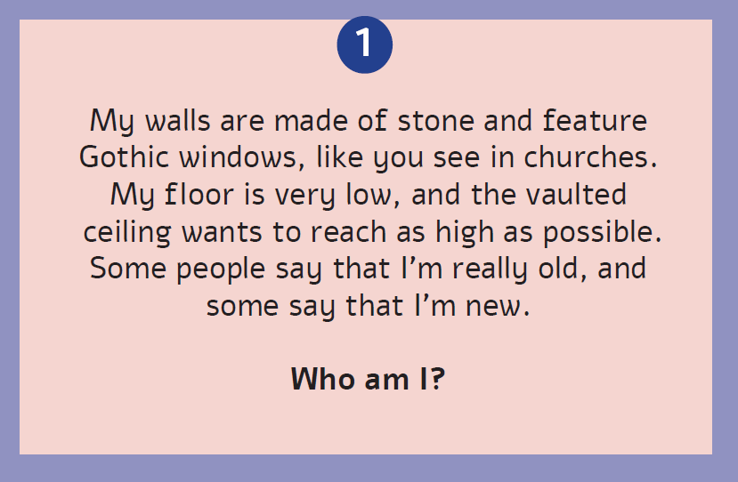

Slide 17
Celebrating Israel’s 70th
Tour (time frame: 1.5-2 hours)
Includes 3-4 Galleries: Synagogue Gallery / Dylan / Operation Moses / CHIM / Jewish Lens / Jewish Humor / Glimpse into Heroes
+ Summary (15 minutes)
Methods
Use smartphones: choose a display that symbolizes Israel for you
Share experiences and memories: relating to Israel and their life/community, or Jerusalem for the first time
Museum Midrash - Chim / Jewish Lens
Optional work shop (Up to 1 hour)
You&I&the Israeli story
Film workshop (Israel at 70, Operation Moses)

Slide 19
Repairing the World: A Path to Social Action
Tour (time frame: 1.5-2 hours)
Includes 3-4 Galleries: Heroes / Synagogue Gallery / CHIM
Optional: Operation Moses, Dylan, Jewish Lens, Humor
+ Summary (15 minutes)
Methods
Use Smartphones: choose a display that reflects Jewish values, leadership, action
Sharing experiences: have the participants share stories related to their community work,
- Museum Midrash – Chim / The Jewish Lens
Optional Workshop in classroom or in gallery (45 min):
Tikkun Olam
Tools for workshop: Rambam cards, Spielberg video

Slide 20
Repairing the World: A Path to Social Action
Target Audience:
Student programs
Goals/Themes:
• To consider the relationship between one's individual values in context with the broader story of the Jewish people.
• To introduce the 6 Jewish Peoplehood concepts, emphasizing Jewish values
• To examine the connection between values and leadership as possible triggers for social action.
• Changing the world, making an impact
• How do Jewish communities foster social action
• Tikkun Olam

Slide 21
Repairing the World: A Path to Social Action
See detailed page handout

Slide 22
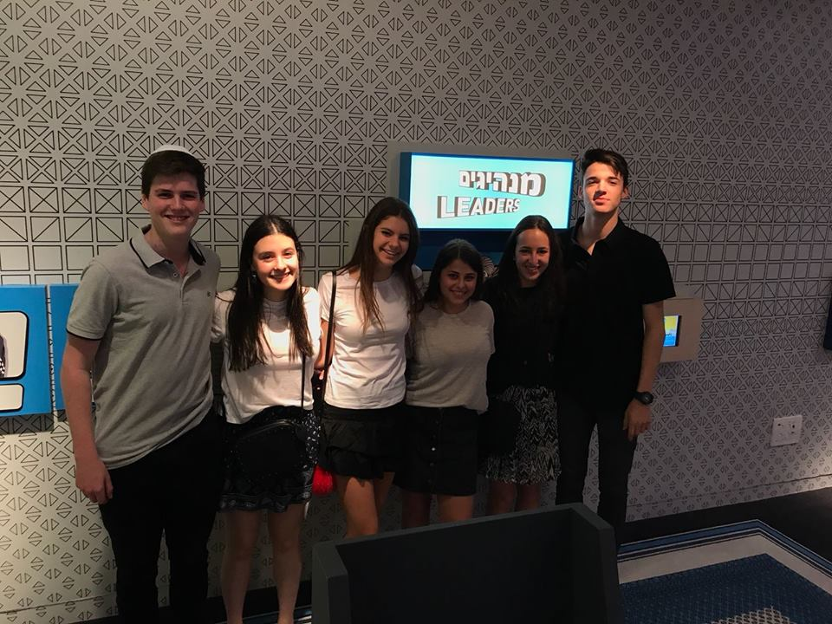
Group Photo!

Slide 23
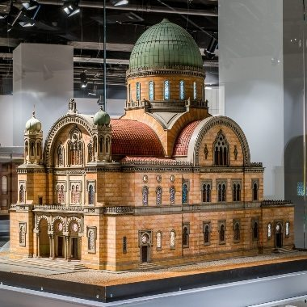
Build Your Own Synagogue My Story, Our Story Workshop

Slide 24
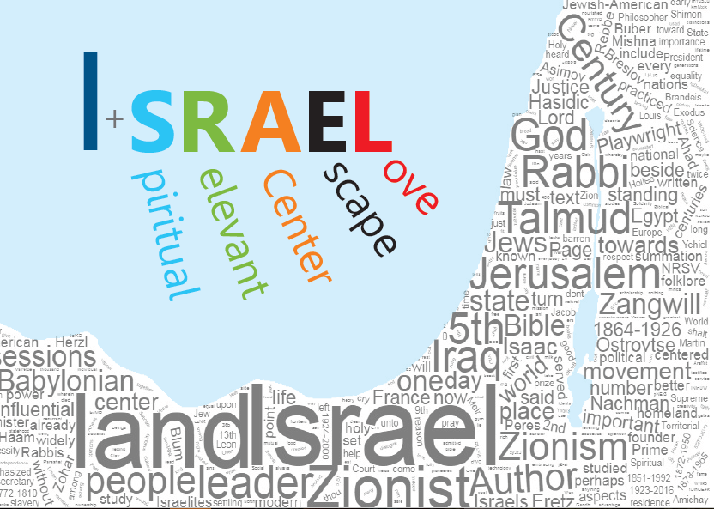
You & I & the Israeli Story Celebrating Israel’s 70th Workshop

Slide 25
I’m that Jew Inspire Your Story Workshop
#I’m that Jew

Slide 26
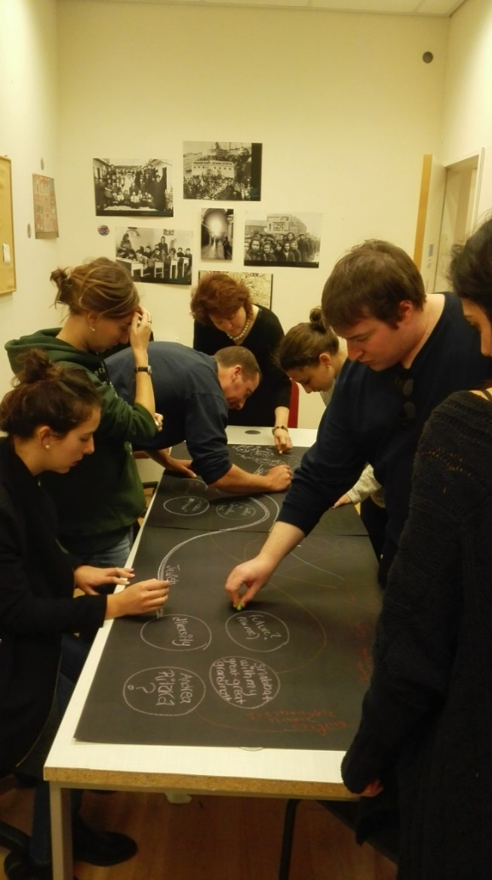
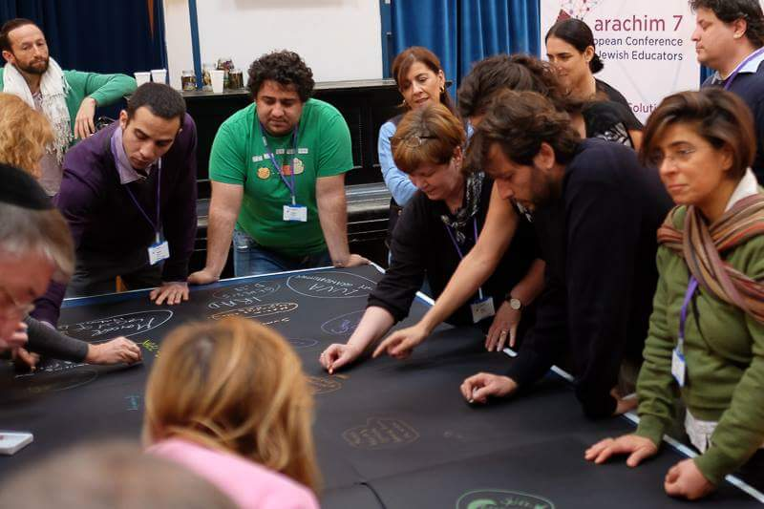
Kesher Amiti הקשר הא/עמיתי Inspire Your Story Workshop

Slide 28
Ron – Israeli name
Shoshana – honoring grandmother
Shabbat service in Poland
Respect
Never give up!
Historical place
Birthright
Complicated love…
David – biblical name
Jessica Leah – Hebrew name
Hebrew celebration
Tikun Olam
My son’s Bar Mitzvah
Telling the truth
Visiting Beit Hatfutsot ☺
Homeland

Slide 29
Ron – Israeli name
Shoshana – honoring grandmother
Shabbat service in Poland
Tradition
Respect
Learning from the past
Ivrit D’aber Ivrit!
Never give up!
Historical place
Birthright
Complicated love…
The Torah
Next generation?
Israel
Ancient Values
David – biblical name
Jessica Leah – Hebrew name
Hebrew celebration
Tikun Olam
Modern Israel
My son’s Bar Mitzvah
Telling the truth
Visiting Beit Hatfutsot ☺
Homeland
Collective Memory

Slide 30
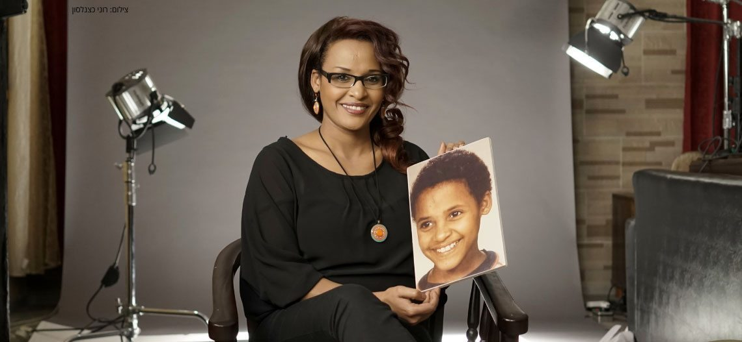
Operation Moses: 30 Years Later Film Workshop

Slide 31
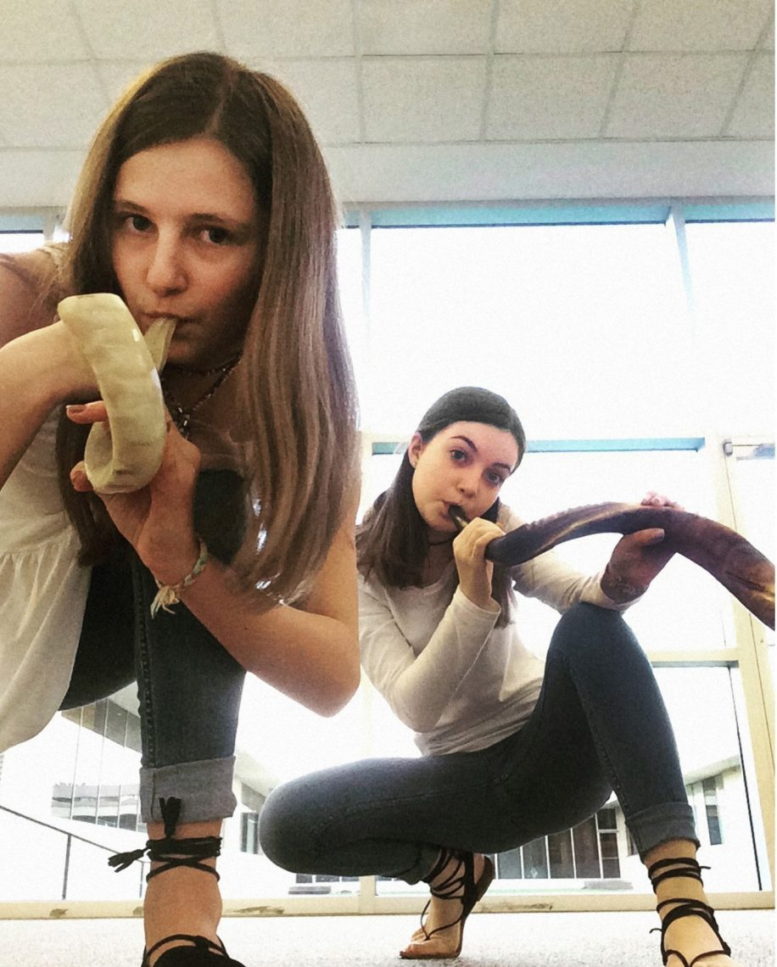
Worldwide BH Programs

Slide 32
While passing by the databases – you can mention the BH Databases - they can find family history, trees etc… all online!

