Slide 1
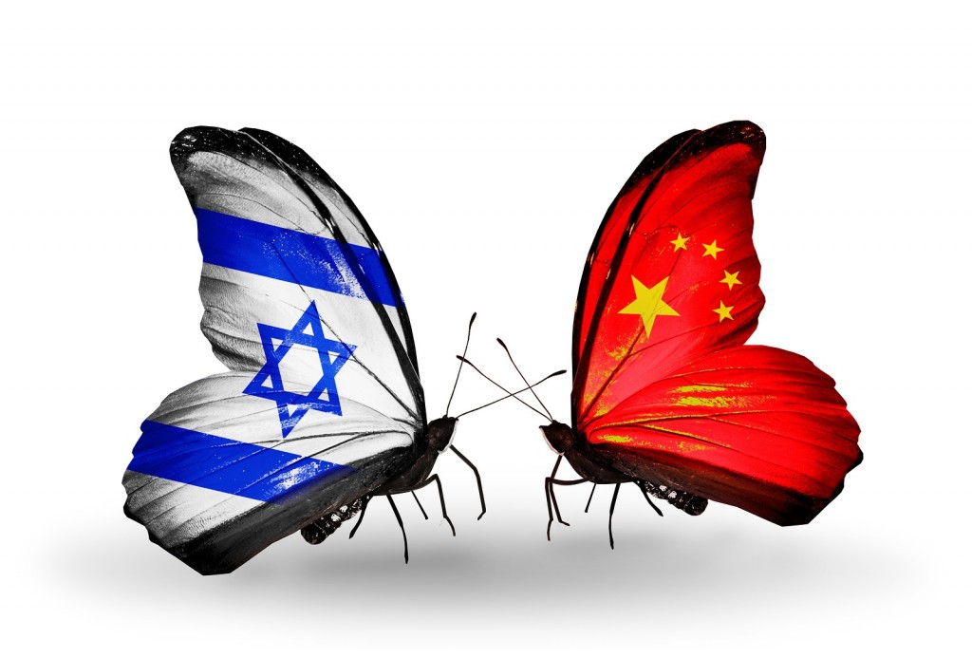
Chinese Visitors at ANU
2023

Slide 2
After three years in which Chinese citizens were in lockdown due to the Covid-19 pandemic, they are very excited to travel the world.
As of August 2023 (last month!) Israel is on the "white" list of countries that Chinese tourists can fly to.
Up until now, there have been only few business delegations that made personal visas, but from now on they can issue a group visa. More and more organized groups are planning their next trip to Israel.

Slide 3
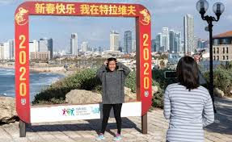
We believe that every Chinese visitor arriving in Israel must visit ANU for a meaningful and fun experience.
This will improve their overall Israel visit, and can improve Chinese-Israeli relations in the future.

Slide 4
China has the largest outbound tourism market in the world.
In 2018, over 160 million Chinese tourists traveled the world.
In 2019, about 442,000 tourists from China arrived in Israel, an increase of 49% compared to 2018.
Chinese tourists spend a considerable amount while visiting Israel- around 1000nis per day.
Chinese tourists prefer to travel to countries close to them: Japan, Thailand, and South Korea, and then to Italy, France, and Spain. Just recently (August 2023), Israel was re-opened as an approved destination for the Chinese audience.

Slide 5
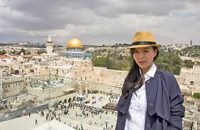
Who are the Chinese visitors coming to Israel, and why are they coming?
Professional or university delegations
University students
Young professionals in fields of business, politics, science, law
Here to meet with their Israeli counterparts, and learn about Israeli innovation
Mainly ages 18-60
Religious groups
Mainly Christian groups here to see Christian holy sites
All ages; may have multiple family generations in one group

Slide 6
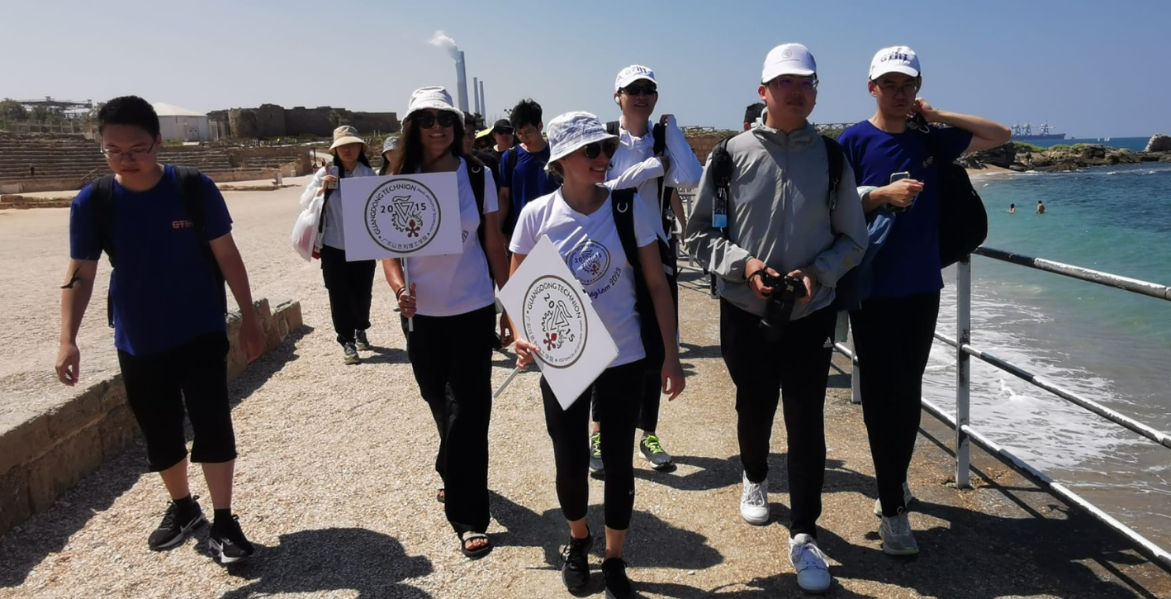
Who are the Chinese visitors coming to Israel, and why are they coming?
Middle class group travel
Arriving in groups with family, friends or neighbors as part of general tourism
All ages; may have multiple family generations in one group
Educators
Arriving in groups based in their schools, universities or other educational frameworks
Mainly ages 25-60

Slide 7
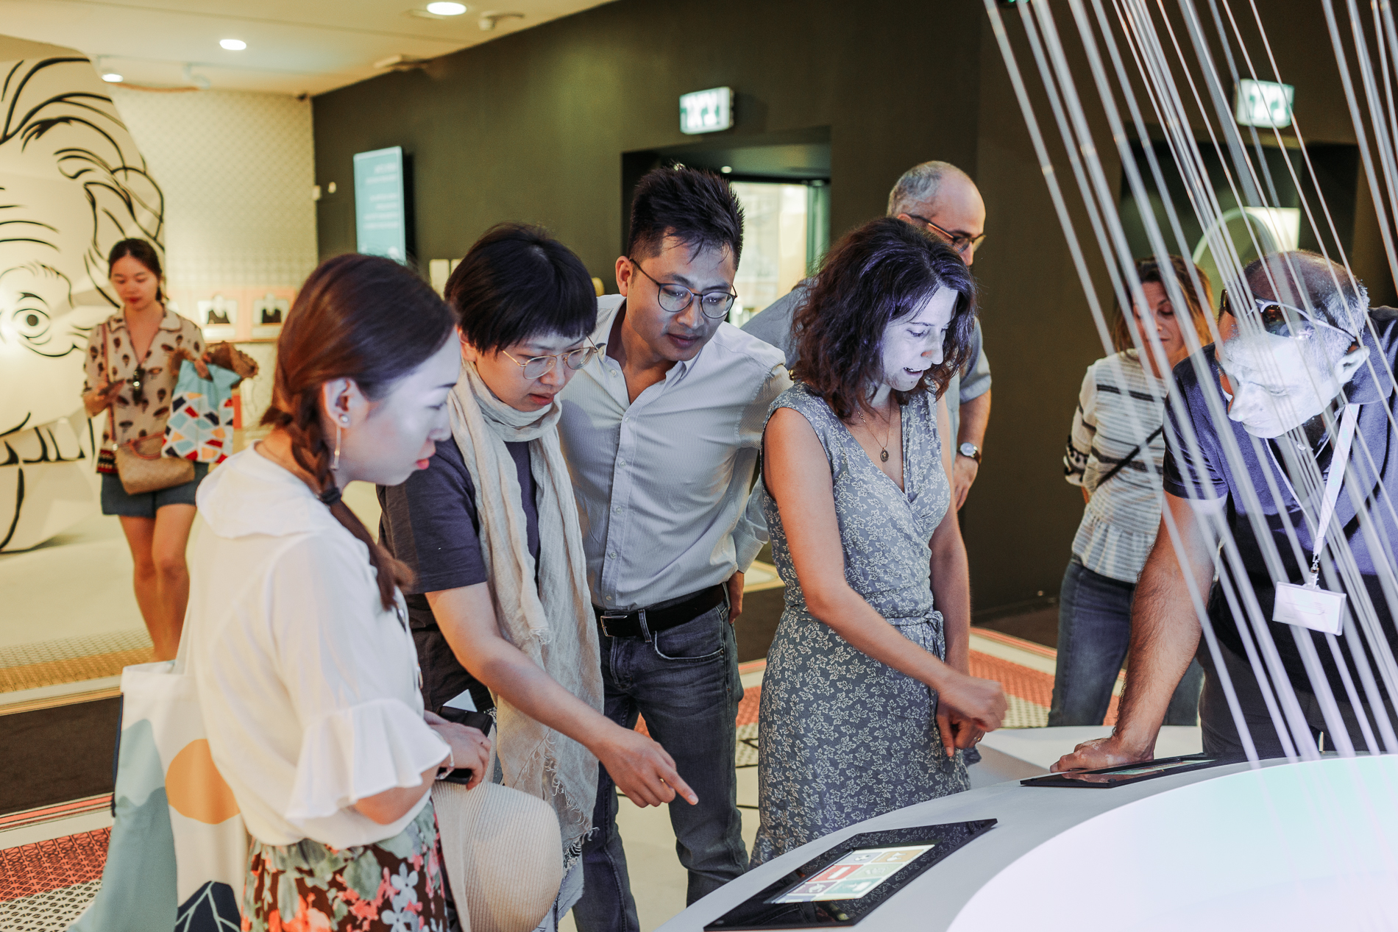
What understanding + assumptions do Chinese visitors arrive with?
‘Jewish Genius’: many Chinese visitors associate Jews with economic success
Economic success = intelligence
Curious about Jewish traditions
Minimal understanding of Jewish peoplehood
Do not understand diversity of Jewish people, or why Israel is important to Jews

Slide 8
How to guide a Chinese group
Since most Chinese visitors have little to no understanding of Jews, use clear and easy to understand basic terms. They know that there are a group of people called Jews, but after that they don’t know what that means.
Start from the very beginning: Jews are a people that have shared religious beliefs and history, but differ in culture and appearance.
Some groups speak English; some will come with translator.

Slide 9
How to guide a Chinese group
Highlight similarities between Chinese and Jewish identities:
Connection to family
Adherence to ancient traditions
Respect for elders
Emphasis on education
Significance of ancient texts with special writing
Understanding of a diaspora community

Slide 10
What is important for them to get from ANU?
Professional/university delegations: Israeli innovation; how Jews thrive in the modern world while still keeping traditions
Christian groups: Jewish basis of Christianity
Middle class groups: similarities between Jews and Chinese; role of China in saving Jews during WWII
Educators: Israeli innovation; Jewish emphasis on education and literacy; texts and traditions

Slide 11
Cultural Tips
When greeting them, a slight bow of the head is preferable to handshake.
If there is a V.I.P within a group, you should mainly contact them during the tour.
No talking politics: neither Israeli nor Chinese. (True for every group!)
Do not point at something with one finger; point with your entire hand instead.
If you receive a gift, it is customary to open it after the tour (not in front of them).
Present and receive a gift and a business card with both hands.
Never give a watch or something associated with time as a gift because it symbolizes the time running out until death.

Slide 12
Cultural Tips
The number 4 symbolizes death, that's why there are high-rise buildings without the 4th floor in China.
Pay attention to their holidays such as the Chinese New Year or October 1st . They will appreciate your attempt to understand their culture.
Chinese National Day is on October 1, which is an annual public holiday celebrated in the People's Republic of China. This day marks the end of dynastic rule and the march towards democracy. It is an important milestone in the rich history of the People's Republic of China.

Slide 13
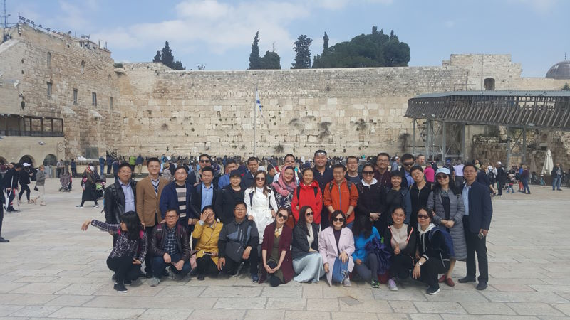
Marketing to Chinese Groups
The Israeli Ministry of Tourism works to market Israel in China while improving the tourist experience. What is the most effective method? Invite Chinese bloggers and influencers to Israel!
Encourage them to take pictures with parts of the museum and to post about ANU on their social media platforms. Facebook and Instagram are banned in China; WeChat or Weibo instead.

Slide 14
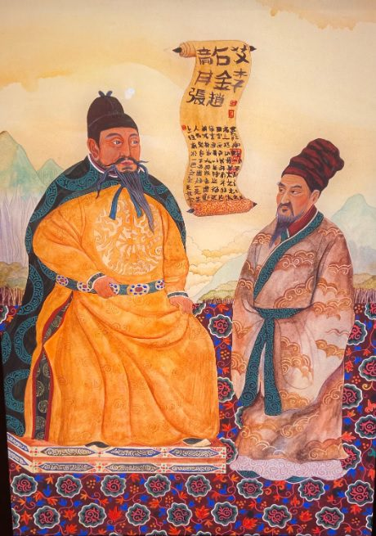
At ANU
Specially created tour for Chinese visitors + staff training
WePay in the ANU store
Working to move Kai Fung Synagoue to Halleluja
ANU Audio Guide in Mandarin
Working to add parts of the ANU site in Mandarin

Slide 15
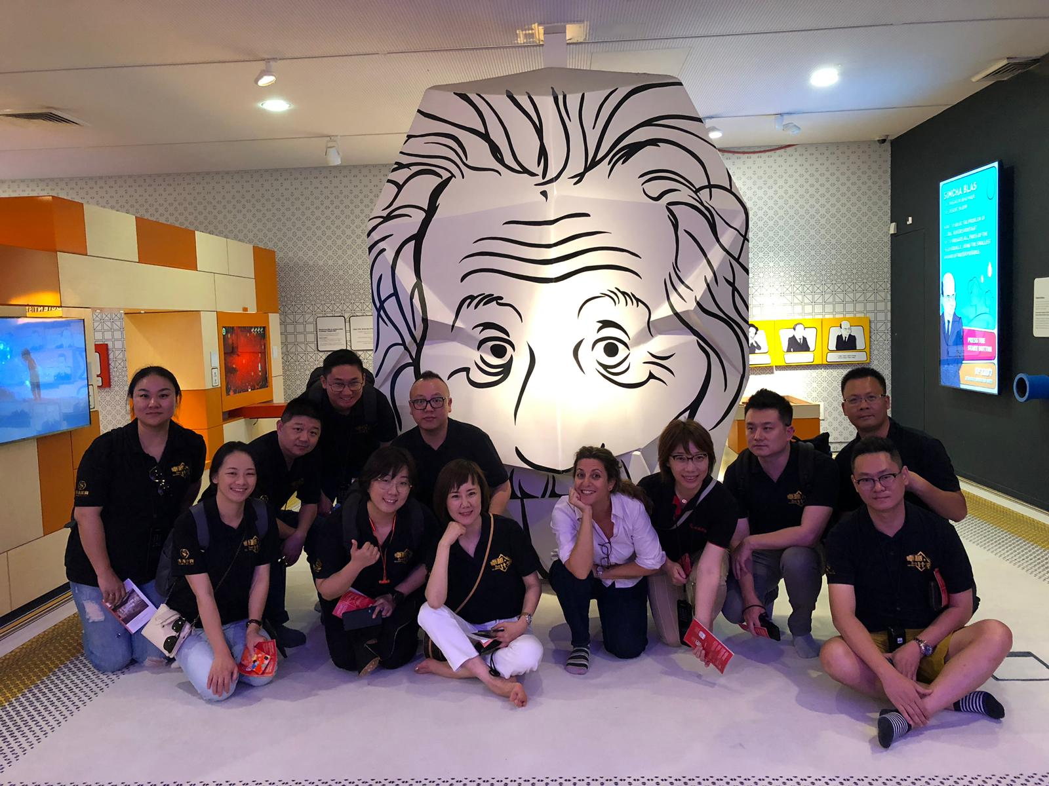
XIE XIE (Thank you!)

