Slide 1
International Groups
ANU- Museum of the Jewish People
June 2022
בית הספר ללימודי העם היהודי
אנו - מוזיאון העם היהודי

Slide 3
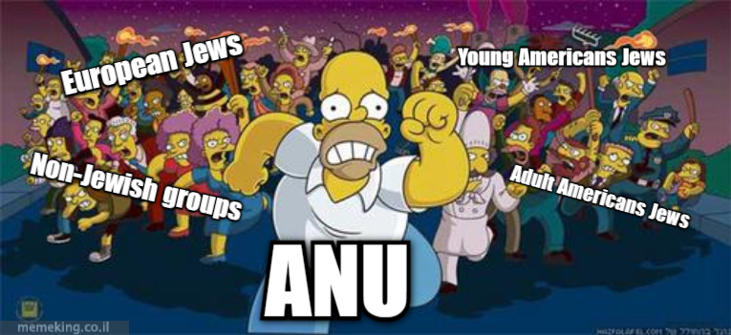
Who is coming to the museum?
Adult Jewish groups
Young Jewish groups
Non-Jewish groups
Christian groups
9176891130

Slide 4
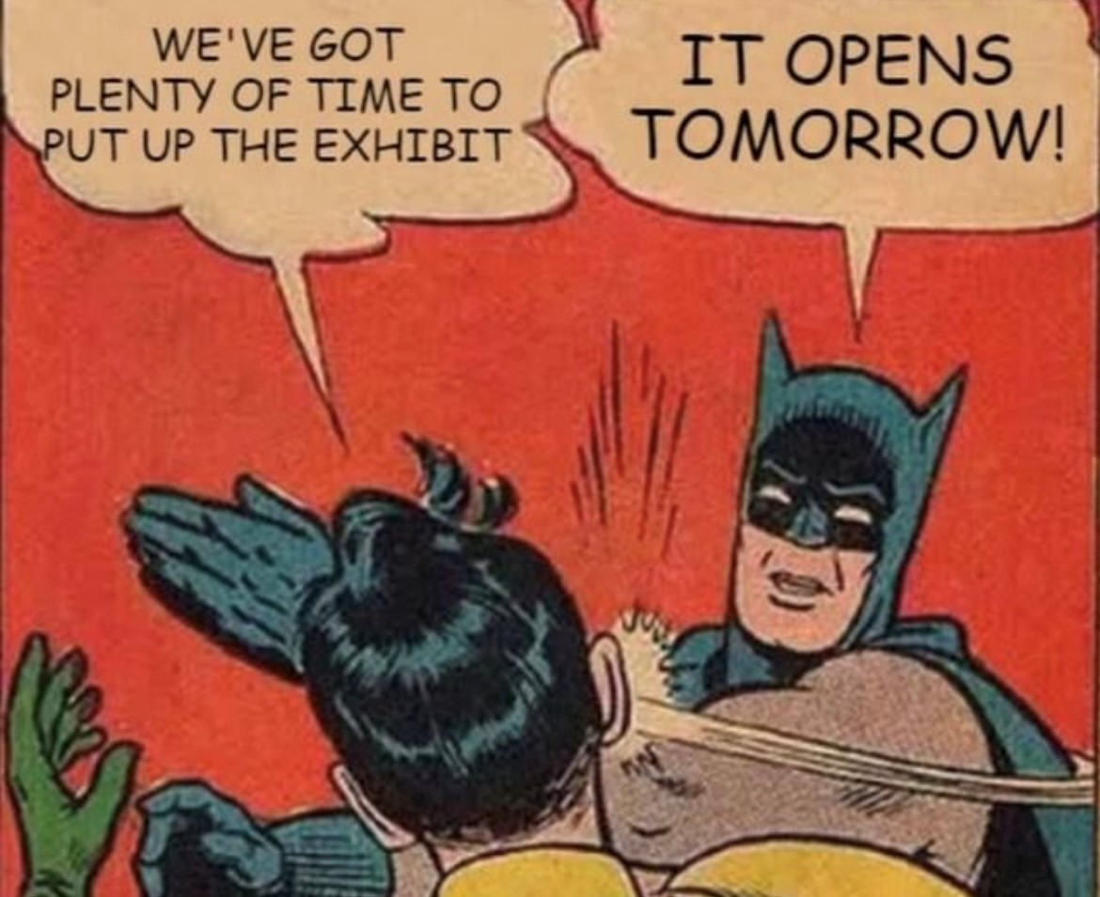

Slide 5
Important to Remember:
Any group coming to ANU has a limited amount of time in Israel, and their schedules are often incredibly full.
We are honored to welcome them to the museum and get their time. We should take this responsibility and give them a great experience, to confirm that it’s worthwhile to come to ANU! Encourage taking pictures!

Slide 6
Adult English-speaking Jews (USA, Canada, UK, South Africa, Australia)
Usually come to the museum because they are emotionally connected and committed to the notion of Jewish identity/peoplehood.
Have strong connections to cultural Jewish identities: food, music, film, etc.
Limited knowledge of non-Ashkenazi Jewish culture and history
Many are coming from liberal, pluralistic communities and therefore with certain cultural assumptions.

Slide 7
Young English-speaking Jews
Birthright Israel (Taglit), Masa, RootOne
Coming to the museum as part of an organized Israel trip. Will likely also be visiting Jerusalem, Kinneret, Negev
Generally not as strongly connected to their own Jewish identity as the previous generation; can display apathy.
Little knowledge of their pre-American roots.
Many grew up with a liberal, pluralistic Judaism.
This group is at the forefront of exposure Israel-based antisemitism
(social media, college campuses)

Slide 8
European Jews
Western Europe: Generally more traditional than most American Jewish groups. May be coming with more knowledge about Jewish practice and history.
Eastern Europe: Less knowledgeable about Jewish traditions and spirituality, but have a strong Jewish identity.
Recommend not to focus in the tour on the American Jewish story, prepare anecdotes on different Jewish cultures.

Slide 9
Christian Groups
Coming as part of church/community trips to see Christian holy sites (Bethlehem, Nazareth, Gallilee, etc.). Example: Passages
Range in ages, political beliefs and streams of Christianity
Not all middle-aged, Republican (politically conservative), Evangelicals
May have exposure to Jewish culture through American culture
Ask: What do you know about Jewish Peoplehood? Make them feel like they have a place to be open
Unaware of the Jewish foundations of Christianity, nor complicated history of Christians and Jews
Future allies against antisemitism

Slide 10
Non-Jewish Groups- American/European
Usually come to museum to gain historical/academic knowledge, not for a personal reason.
Part of university or professional delegation. Likely will be looking at Israel not only as the Jewish Homeland, but also through the Palestinian/Israeli Arab lens as well.
Expect little prior knowledge of Jewish history, culture or spiritual practices. They may be familiar with historical events, but through a non-Jewish lens.
This may be the first time they meet or speak with a Jew, or the first time they learn that Jews do not all look the same way as in their home country.
Encourage question asking and getting out of their shell.

Slide 11
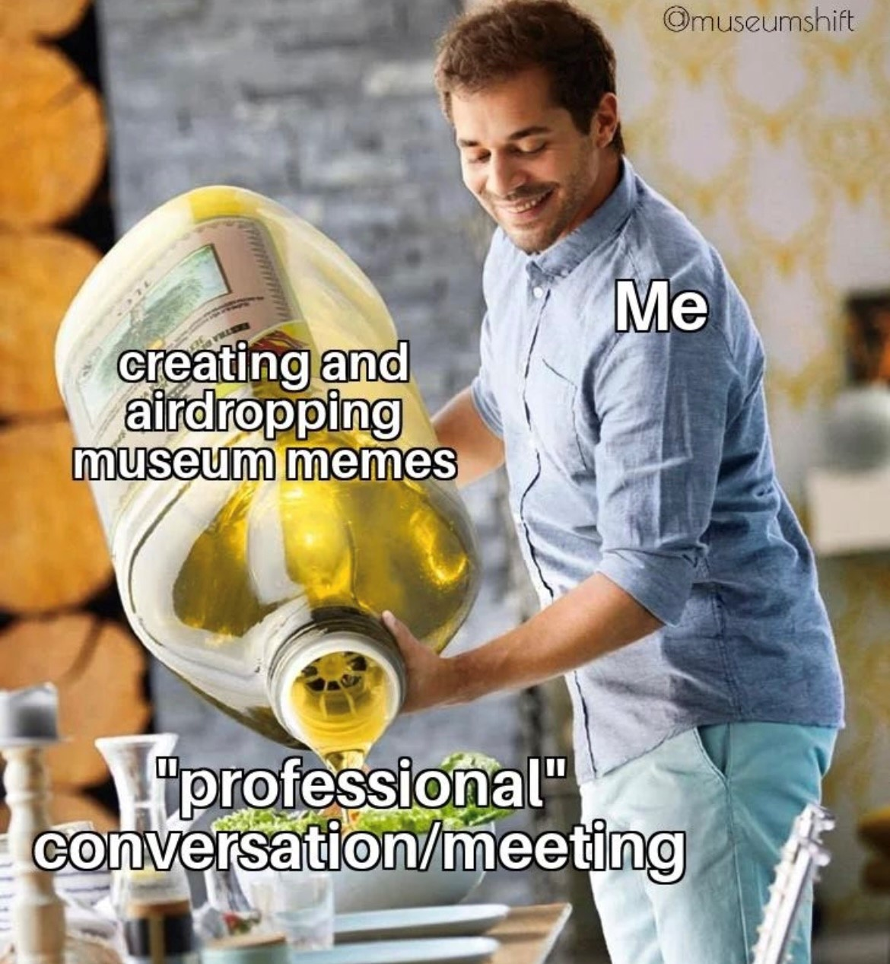

Slide 12
What do we offer?
Active and educational tours for young Jews
Highlights tour for Adult Jewish groups
Informative tours for Christian groups, based on Judeo-Christian relations
Tour for non-Jewish groups
For the independent visitor: https://anu.voa.co.il/#/home/anu

Slide 13
Highlights Tour, with adjustments, for Adult American Jews
90-minute Highlights tour (in Dropbox)
Good to include:
RBG
Great Migration
Modern arts that can contribute to the discussion on modern Jews today (Kapparot, Carol Hamoy, Kiddush-To-Go(
Belmonte Lamp

Slide 14
Educational tours for young American Jews
MASA Tour – Tour 90 min + Workshop 45 min
Birthright Israel (Taglit) – Highlights Tour 90 min + optional workshop
Taglit RFID
RootOne – Highlights Tour 90 min

Slide 15
Tour for Christian groups
Tour: 90 min- Judeo Christian Foundations and Relationships

Slide 16
Tour for non-Jewish groups
Highlights Tour- Dropbox
Emphasize and show the groups that are the Jewish people today, the different Jewish identities and Jewish culture through the museum.
Show the complexity of Jewish culture as a way to define a Jewish identity
Explain the concept of Peoplehood.
Show historical events they may be familiar with, but through a Jewish lens

Slide 17
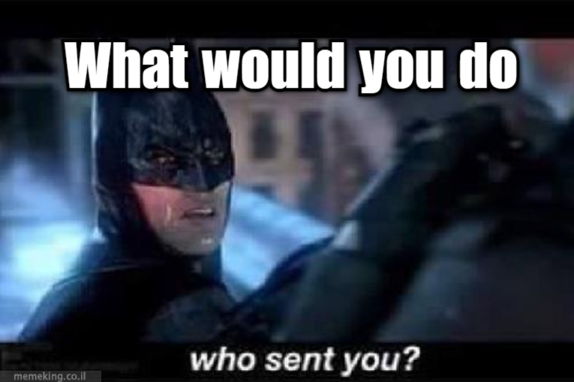
W.W.Y.D Improv
What is Judaism? Race? People? Religion?
Why do people hate Jews?
Why doesn’t the museum have anything about South American Jews?
Why are you showing so many Reform/Conservative/Orthodox/secular Jews? They are not really Jewish!
Why you don’t talk about the Israeli-Palestinian conflict?
Why don’t you have more information on the Shoah?
Why do Jews control Hollywood?

Slide 18
I’m Rachel, age 19 from birthright, and don’t want to hear about Jewish identities, came to Israel to have fun – What will interest me in the museum?
I’m Fernando, I’m from brazil, age 25 , just finish MBA , and needed a breakaway from my life. I came with MASA to Israel for 5-10 months to experience new opportunities and think about my future - What will interest me in the museum?
A visitor ask: what is the old testemont? What is the difference from the bible?

Slide 19
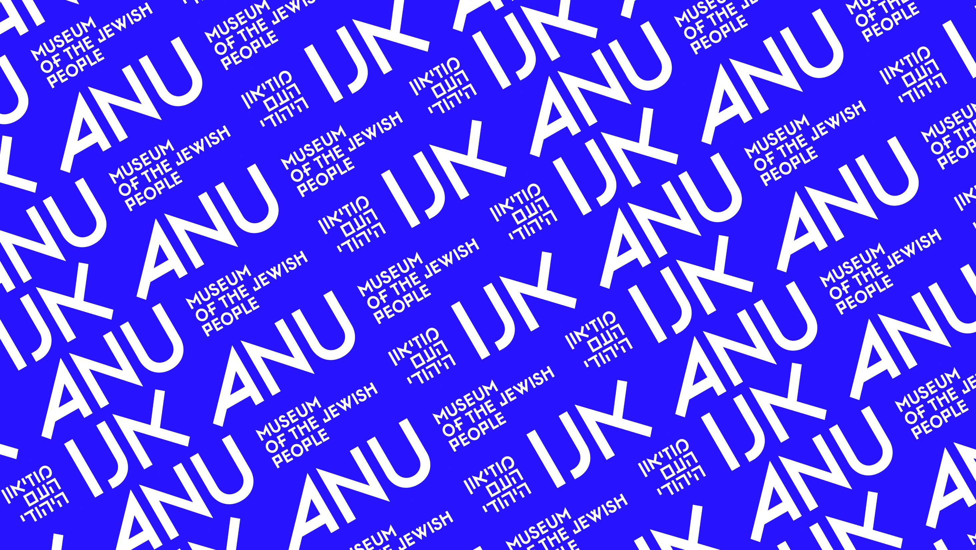
Thank you ☺

