Slide 1
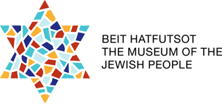
Jewish Peoplehood You are part of the story

Slide 2
A Story About Us
Some time ago, I met a beautiful woman
Whose grandfather performed my Brit Milah
Long before she was born. I told her,
You don't know me and I don't know you
But we are the Jewish people.
Your dead grandfather and I the circumcised
and you the beautiful granddaughter
with golden hair: We are the Jewish people.
The Jews / Yehuda Amichai

Slide 3
Peoplehood: Converting Structures into Assets
Jewish creation and creativity
The world of Jewish values
Jewish practices and spirituality
Historical memory
Hebrew and Jewish languages
Israel as a multidimensional concept (Eretz, moledet, medinah)

