Slide 1
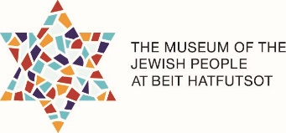
Did You Know?
Fun Facts about the Jewish World

Slide 2
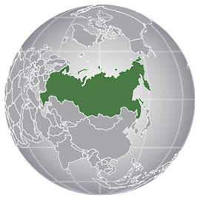
Russia
1. During the Cold War (Post-WWII to 1991) all Jewish practice and education occurred underground.
2. Between 1989 and 2006, roughly 980,000 Jews immigrated to Israel from the Former Soviet Union.

Slide 3
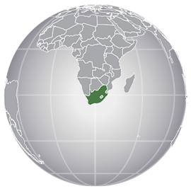
South Africa
1. 90% of all the Jews in South Africa are Litvak (Lithuanian).
2. Portuguese Jewish mapmakers came to South Africa as early as the 15th century; they came via ships of famous explorers such as Vasco de Gama.

Slide 4
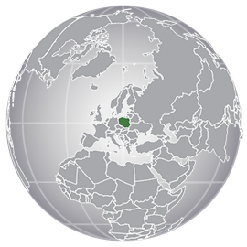
Poland
1. Some of the first Jews to settle in Poland were traders from Spain in the modern period, Poland was called “Po Lan Ya” in Hebrew, meaning “God resides here”, noting how welcoming it was for Jews.
2. In the interwar years (1918-1939), Poland had a Jewish party in parliament.

Slide 5
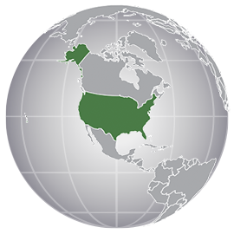
United States
1. Many superheroes that we know and love today were created by Jewish authors: Superman, Batman, The Hulk, Captain America, and many more!
2. The oldest Jewish community in North America was established in New Amsterdam (later New York City) in 1654.

Slide 6
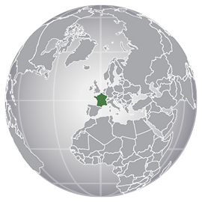
France
1. One of the most famous Jewish scholars, Rashi, was French.
2. France is the third largest Jewish community in the world.

Slide 7
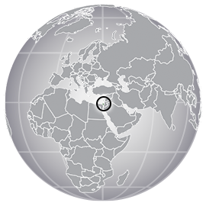
Israel
1. The glue on Israeli postage stamps is kosher.
2. Alexander the Great is said to have entered Israel in 333 B.C.E. via the caves at Rosh Hanikra.

Slide 8
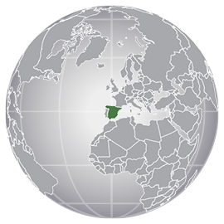
Spain
1. One of the most famous Jewish scholars, Maimonides, was Spanish.
2. The term “Sephardim” indicates Jews who are of Spanish or Portuguese descent.

Slide 9
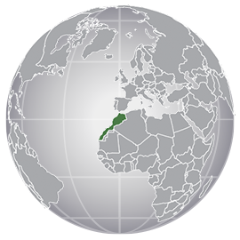
Morocco
1. In 1948 more than 250,000 Jews were living in Morocco; now there are just around 2000.
2. Immigration to Israel was banned in Morocco from the years 1956 to 1963.

Slide 10
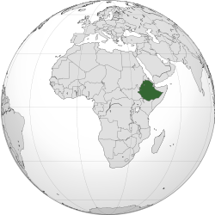
Ethiopia
1. The term for Ethiopian Jews is Beta Israel.
2. In Ethiopian Jewish culture, the Torah is referred to as Orit.

